Slide 1
Able to Build a web application on modern cloud-based architectures and services
(75 hours)
Notes:
Title - The learning outcome
Subtitle - Duration

Slide 2
In this section, we will discuss:
Container applications
Docker
Kubernetes
Services in cloud supporting container applications
Hybrid Application scenarios
Architectures and best practices
Notes:
Mention the parent topics one by one. This particular learning outcome has 4 parent topics.

Slide 3
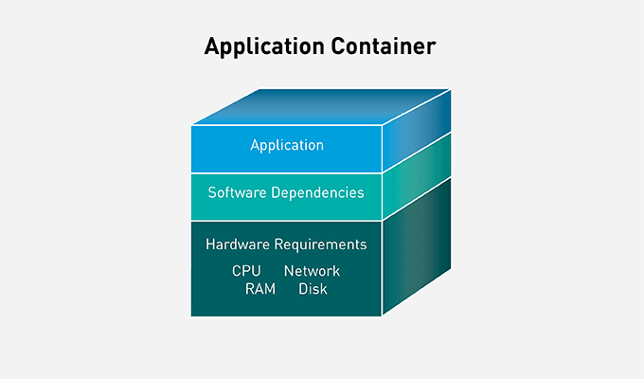
Container applications
What are containers?
Containers are executable units of software in which application code is packaged,
Along with its libraries and dependencies, in common ways so that it can be run anywhere, whether it be on desktop, traditional IT, or the cloud.
Image Source: https://developer.hpe.com/blog/kubernetes-application-containers-managing-containers-and-cluster-resour/
Notes:
Left (White Color space):
Title - Parent Topic
Subtitle - Subtopic 1
Body Text - Description in bullets
Right (Grey Color Space):
Body Text - Relevant image (with source)/code snippet
Put reference links in Speaker Notes
Reference:
https://www.tutorialspoint.com/internet_technologies/internet_overview.htm/

Slide 4
Container applications
Benefits of containers
Lightweight
Portable and platform independent
Supports modern development and architecture
Improves utilization
Image Source: https://developer.hpe.com/blog/kubernetes-application-containers-managing-containers-and-cluster-resour/
Notes:
Left (White Color space):
Title - Parent Topic
Subtitle - Subtopic 1
Body Text - Description in bullets
Right (Grey Color Space):
Body Text - Relevant image (with source)/code snippet
Put reference links in Speaker Notes
Reference:
https://www.tutorialspoint.com/internet_technologies/internet_overview.htm/

Slide 5
Container applications
Use cases for containers
Microservices
DevOps
Hybrid, multi-cloud
Application modernizing and migration
Image Source: https://developer.hpe.com/blog/kubernetes-application-containers-managing-containers-and-cluster-resour/
Notes:
Left (White Color space):
Title - Parent Topic
Subtitle - Subtopic 1
Body Text - Description in bullets
Right (Grey Color Space):
Body Text - Relevant image (with source)/code snippet
Put reference links in Speaker Notes
Reference:
https://www.tutorialspoint.com/internet_technologies/internet_overview.htm/

Slide 6
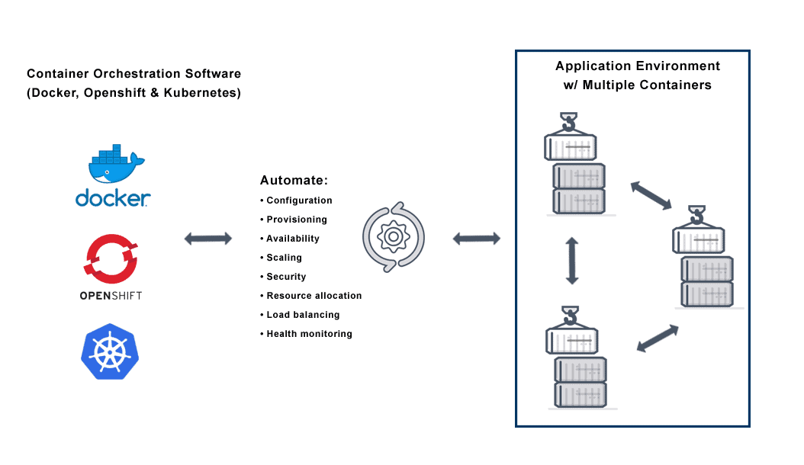
Container applications
Container orchestration with Kubernetes
Kubernetes enables developers and operators to declare a desired state of their overall container environment through YAML files, and then
Kubernetes does all the hard work establishing and maintaining that state
Image Source: https://avinetworks.com/glossary/container-orchestration/
Notes:
Left (White Color space):
Title - Parent Topic
Subtitle - Subtopic 1
Body Text - Description in bullets
Right (Grey Color Space):
Body Text - Relevant image (with source)/code snippet
Put reference links in Speaker Notes
Reference:
https://www.tutorialspoint.com/internet_technologies/internet_overview.htm/

Slide 7

Docker
What is it?
Docker is a container management service.
The keywords of Docker are develop, ship and run anywhere.
The whole idea of Docker is for developers to easily develop applications, ship them into containers which can then be deployed anywhere.
Image Source: https://aws.amazon.com/docker/
Notes:
Left (White Color space):
Title - Parent Topic
Subtitle - Subtopic 1
Body Text - Description in bullets
Right (Grey Color Space):
Body Text - Relevant image (with source)/code snippet
Put reference links in Speaker Notes
Reference:
https://www.tutorialspoint.com/internet_technologies/internet_overview.htm/

Slide 8
Docker
Features of Docker
Ability to reduce the size of development
Easier for teams across different units to work seamlessly across applications
Deploy Docker containers anywhere
Easily scalable
Image Source: https://aws.amazon.com/docker/
Notes:
Left (White Color space):
Title - Parent Topic
Subtitle - Subtopic 1
Body Text - Description in bullets
Right (Grey Color Space):
Body Text - Relevant image (with source)/code snippet
Put reference links in Speaker Notes
Reference:
https://www.tutorialspoint.com/internet_technologies/internet_overview.htm/

Slide 9
Docker
Components of Docker
Docker for Mac
Docker for Linux
Docker for Windows
Docker Engine
Docker Hub
Docker Compose
Image Source: https://aws.amazon.com/docker/
Notes:
Left (White Color space):
Title - Parent Topic
Subtitle - Subtopic 1
Body Text - Description in bullets
Right (Grey Color Space):
Body Text - Relevant image (with source)/code snippet
Put reference links in Speaker Notes
Reference:
https://www.tutorialspoint.com/internet_technologies/internet_overview.htm/

Slide 10
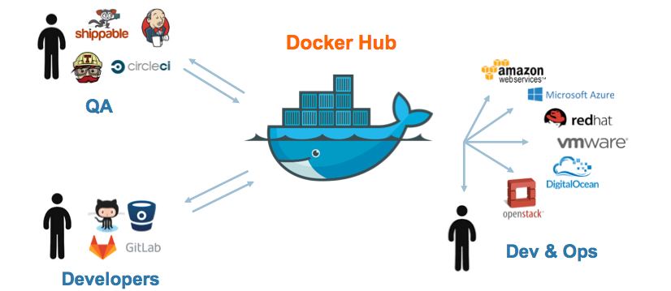
Docker
Docker – Hub
Docker Hub is a registry service on the cloud that allows you to download Docker images that are built by other communities.
Image Source: https://medium.com/docker-captain/creating-the-first-docker-image-and-pushing-it-to-docker-hub-4e02bea48e81
Notes:
Left (White Color space):
Title - Parent Topic
Subtitle - Subtopic 1
Body Text - Description in bullets
Right (Grey Color Space):
Body Text - Relevant image (with source)/code snippet
Put reference links in Speaker Notes
Reference:
https://www.tutorialspoint.com/internet_technologies/internet_overview.htm/

Slide 11
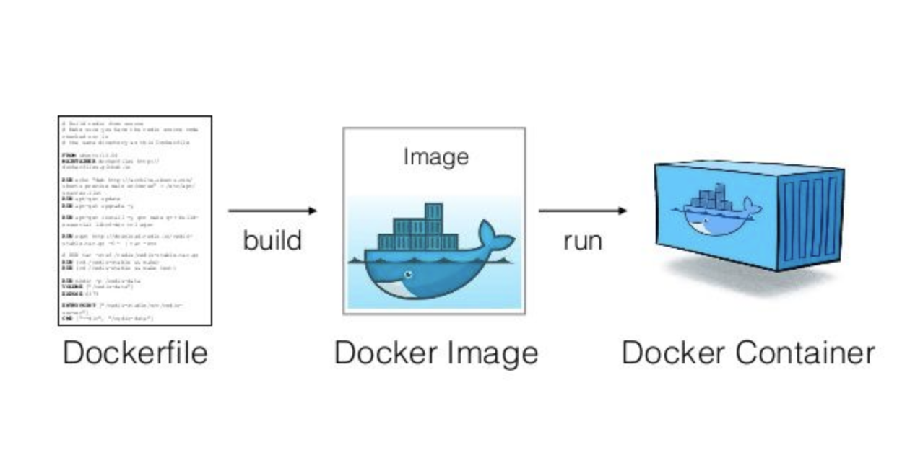
Docker
Docker – Images
In Docker, everything is based on Images.
An image is a combination of a file system and parameters.
Image Source: https://medium.com/platformer-blog/practical-guide-on-writing-a-dockerfile-for-your-application-89376f88b3b5
Notes:
Left (White Color space):
Title - Parent Topic
Subtitle - Subtopic 1
Body Text - Description in bullets
Right (Grey Color Space):
Body Text - Relevant image (with source)/code snippet
Put reference links in Speaker Notes
Reference:
https://www.tutorialspoint.com/internet_technologies/internet_overview.htm/

Slide 12
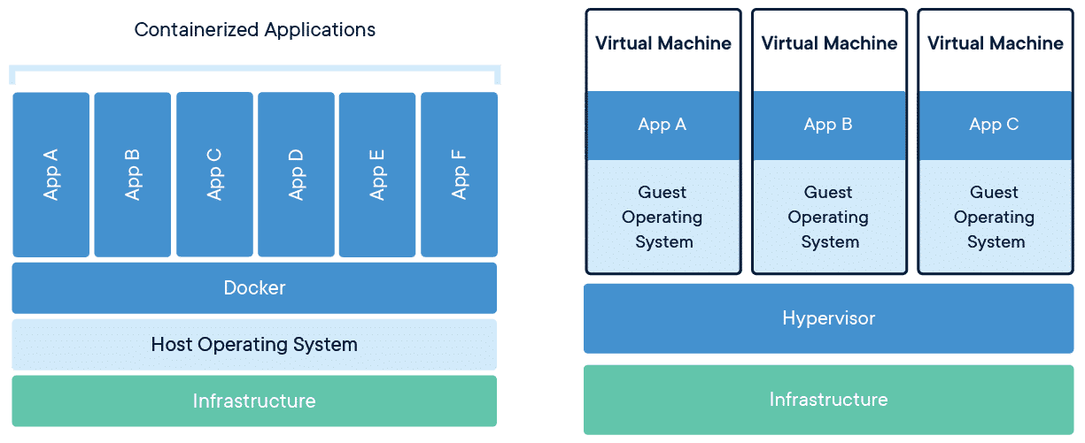
Docker
Docker – Containers
Containers are instances of Docker images that can be run using the Docker run command.
The basic purpose of Docker is to run containers.
Image Source: https://www.docker.com/resources/what-container/
Notes:
Left (White Color space):
Title - Parent Topic
Subtitle - Subtopic 1
Body Text - Description in bullets
Right (Grey Color Space):
Body Text - Relevant image (with source)/code snippet
Put reference links in Speaker Notes
Reference:
https://www.tutorialspoint.com/internet_technologies/internet_overview.htm/

Slide 13
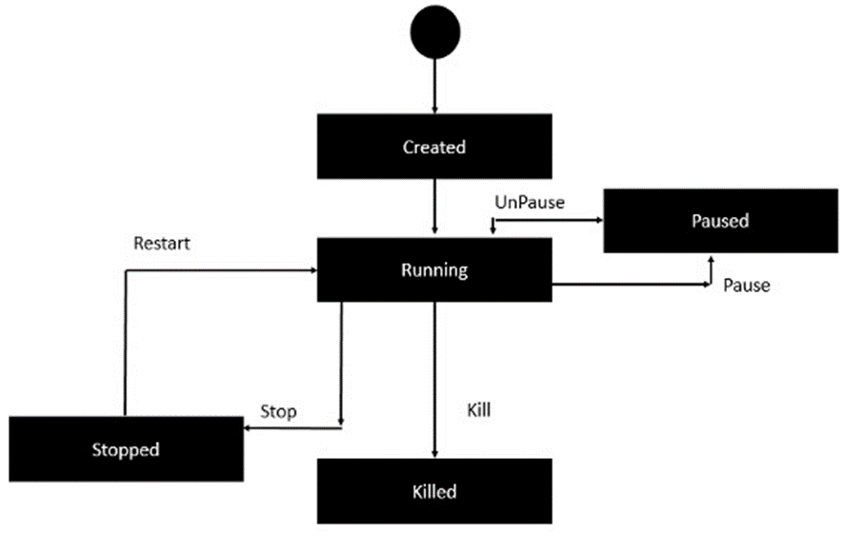
Docker
Docker – Container Lifecycle
The following illustration explains the entire lifecycle of a Docker container.
Image Source: https://www.tutorialspoint.com/docker/docker_working_with_containers.htm
Notes:
Left (White Color space):
Title - Parent Topic
Subtitle - Subtopic 1
Body Text - Description in bullets
Right (Grey Color Space):
Body Text - Relevant image (with source)/code snippet
Put reference links in Speaker Notes
Reference:
https://www.tutorialspoint.com/internet_technologies/internet_overview.htm/

Slide 14
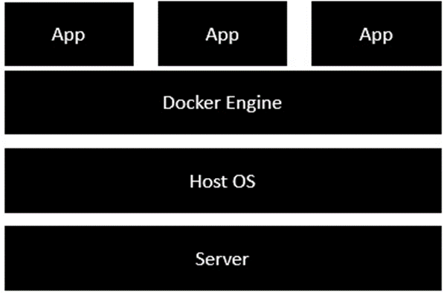
Docker
Docker – Architecture
The server is the physical server
The Host OS is the base machine such as Linux or Windows.
Docker engine is used to run the operating system which earlier used to be virtual machines as Docker containers.
All of the Apps now run as Docker containers.
Image Source: https://www.tutorialspoint.com/docker/docker_architecture.htm
Notes:
Left (White Color space):
Title - Parent Topic
Subtitle - Subtopic 1
Body Text - Description in bullets
Right (Grey Color Space):
Body Text - Relevant image (with source)/code snippet
Put reference links in Speaker Notes
Reference:
https://www.tutorialspoint.com/internet_technologies/internet_overview.htm/

Slide 15
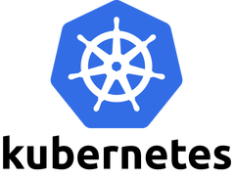
Kubernetes
What is it?
Kubernetes in an open source container management tool hosted by Cloud Native Computing Foundation (CNCF).
Kubernetes comes with a capability of automating deployment, scaling of application, and operations of application containers across clusters.
It is capable of creating container centric infrastructure.
Image Source: https://aws.amazon.com/kubernetes/
Notes:
Left (White Color space):
Title - Parent Topic
Subtitle - Subtopic 1
Body Text - Description in bullets
Right (Grey Color Space):
Body Text - Relevant image (with source)/code snippet
Put reference links in Speaker Notes
Reference:
https://www.tutorialspoint.com/internet_technologies/internet_overview.htm/

Slide 16
Kubernetes
Features
Continues development, integration and deployment
Containerized infrastructure
Application-centric management
Auto-scalable infrastructure
Image Source: https://aws.amazon.com/kubernetes/
Notes:
Left (White Color space):
Title - Parent Topic
Subtitle - Subtopic 1
Body Text - Description in bullets
Right (Grey Color Space):
Body Text - Relevant image (with source)/code snippet
Put reference links in Speaker Notes
Reference:
https://www.tutorialspoint.com/internet_technologies/internet_overview.htm/

Slide 17
Kubernetes
Features
Environment consistency across development testing and production
Loosely coupled infrastructure, where each component can act as a separate unit
Higher density of resource utilization
Predictable infrastructure which is going to be created
Image Source: https://aws.amazon.com/kubernetes/
Notes:
Left (White Color space):
Title - Parent Topic
Subtitle - Subtopic 1
Body Text - Description in bullets
Right (Grey Color Space):
Body Text - Relevant image (with source)/code snippet
Put reference links in Speaker Notes
Reference:
https://www.tutorialspoint.com/internet_technologies/internet_overview.htm/

Slide 18
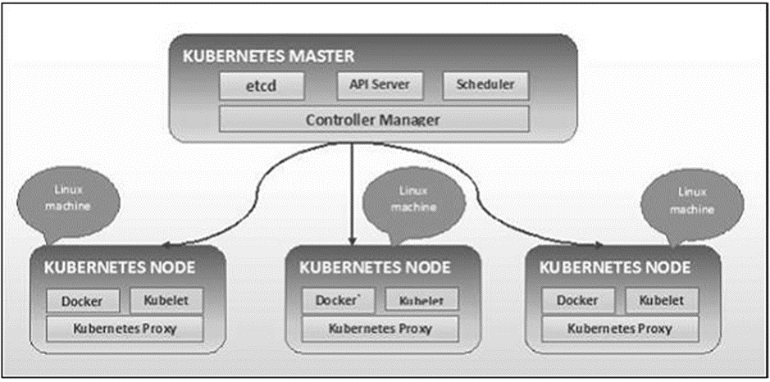
Kubernetes - Architecture
Kubernetes - Cluster Architecture
As seen in the following diagram, Kubernetes follows client-server architecture. Wherein, we have master installed on one machine and the node on separate Linux machines.
Image Source: https://www.tutorialspoint.com/kubernetes/kubernetes_architecture.htm
Notes:
Left (White Color space):
Title - Parent Topic
Subtitle - Subtopic 1
Body Text - Description in bullets
Right (Grey Color Space):
Body Text - Relevant image (with source)/code snippet
Put reference links in Speaker Notes
Reference:
https://www.tutorialspoint.com/internet_technologies/internet_overview.htm/

Slide 19
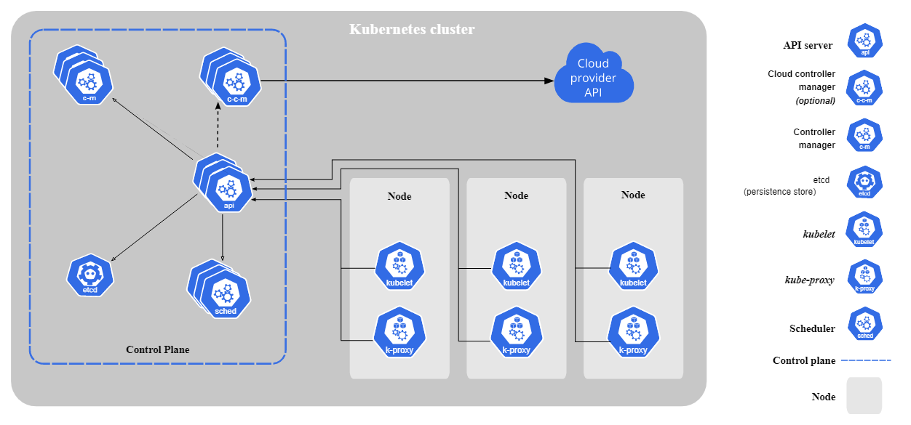
Kubernetes - Architecture
Kubernetes - Master Machine Components
etcd
API Server
Controller Manager
Scheduler
Image Source: https://kubernetes.io/docs/concepts/overview/components/
Notes:
Left (White Color space):
Title - Parent Topic
Subtitle - Subtopic 1
Body Text - Description in bullets
Right (Grey Color Space):
Body Text - Relevant image (with source)/code snippet
Put reference links in Speaker Notes
Reference:
https://www.tutorialspoint.com/internet_technologies/internet_overview.htm/

Slide 20
Kubernetes - Architecture
Kubernetes - Node Components
Docker
Kubelet Service
Kubernetes Proxy Service
Image Source: https://kubernetes.io/docs/concepts/overview/components/
Notes:
Left (White Color space):
Title - Parent Topic
Subtitle - Subtopic 1
Body Text - Description in bullets
Right (Grey Color Space):
Body Text - Relevant image (with source)/code snippet
Put reference links in Speaker Notes
Reference:
https://www.tutorialspoint.com/internet_technologies/internet_overview.htm/

Slide 21
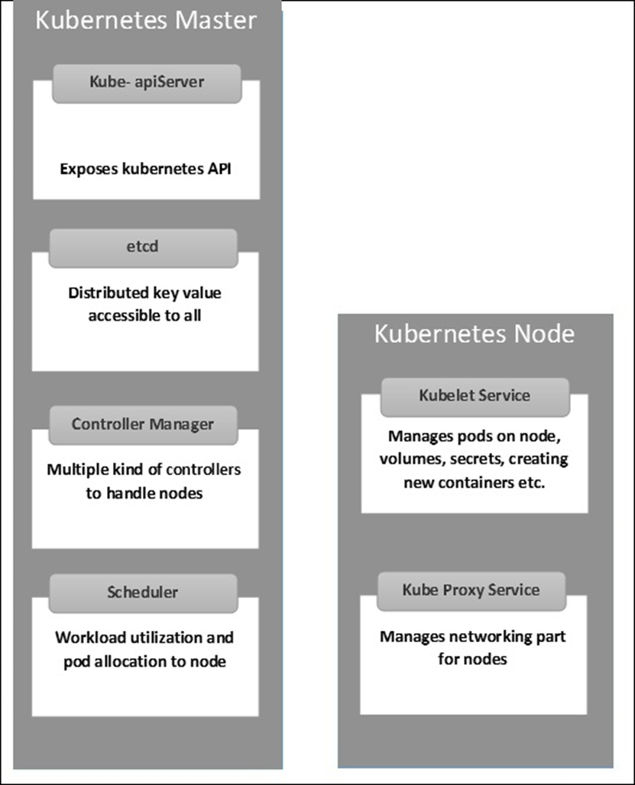
Kubernetes - Architecture
Kubernetes - Master and Node Structure
The following illustrations show the structure of Kubernetes Master and Node.
Image Source: https://www.tutorialspoint.com/kubernetes/kubernetes_architecture.htm
Notes:
Left (White Color space):
Title - Parent Topic
Subtitle - Subtopic 1
Body Text - Description in bullets
Right (Grey Color Space):
Body Text - Relevant image (with source)/code snippet
Put reference links in Speaker Notes
Reference:
https://www.tutorialspoint.com/internet_technologies/internet_overview.htm/

Slide 22
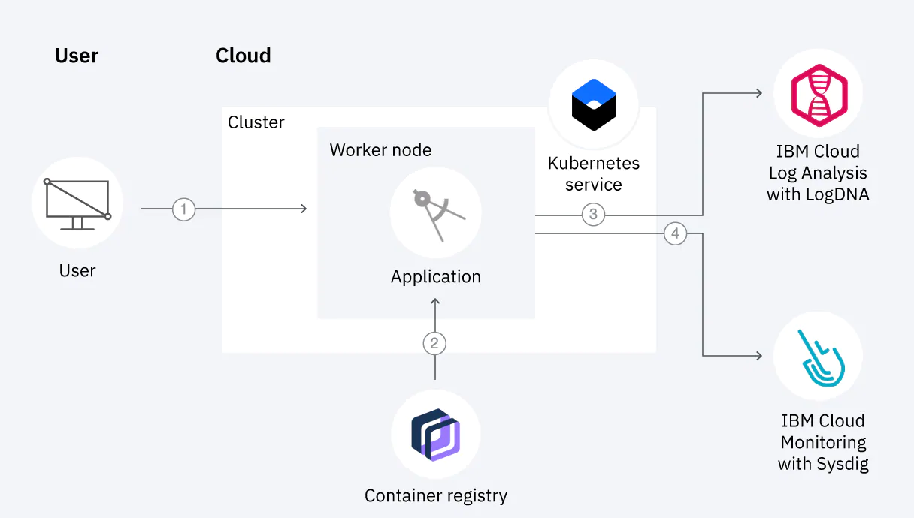
Services in cloud supporting container applications
IBM Cloud Kubernetes Service
We can create our own Kubernetes cluster to deploy and manage containerized apps on IBM Cloud.
The containerized apps are hosted on IBM Cloud infrastructure compute hosts that are called worker nodes.
Image Source: https://www.ibm.com/cloud/kubernetes-service
Notes:
Left (White Color space):
Title - Parent Topic
Subtitle - Subtopic 1
Body Text - Description in bullets
Right (Grey Color Space):
Body Text - Relevant image (with source)/code snippet
Put reference links in Speaker Notes
Reference:
https://www.tutorialspoint.com/internet_technologies/internet_overview.htm/

Slide 23
Services in cloud supporting container applications
Why should I use IBM Cloud Kubernetes Service?
It is a managed Kubernetes offering that delivers powerful tools, an intuitive user experience, and built-in security for rapid delivery of apps that you can bind to cloud services that are related to IBM Watson™, AI, IoT, DevOps, security, and data analytics.
Image Source: https://www.ibm.com/cloud/kubernetes-service
Notes:
Left (White Color space):
Title - Parent Topic
Subtitle - Subtopic 1
Body Text - Description in bullets
Right (Grey Color Space):
Body Text - Relevant image (with source)/code snippet
Put reference links in Speaker Notes
Reference:
https://www.tutorialspoint.com/internet_technologies/internet_overview.htm/

Slide 24
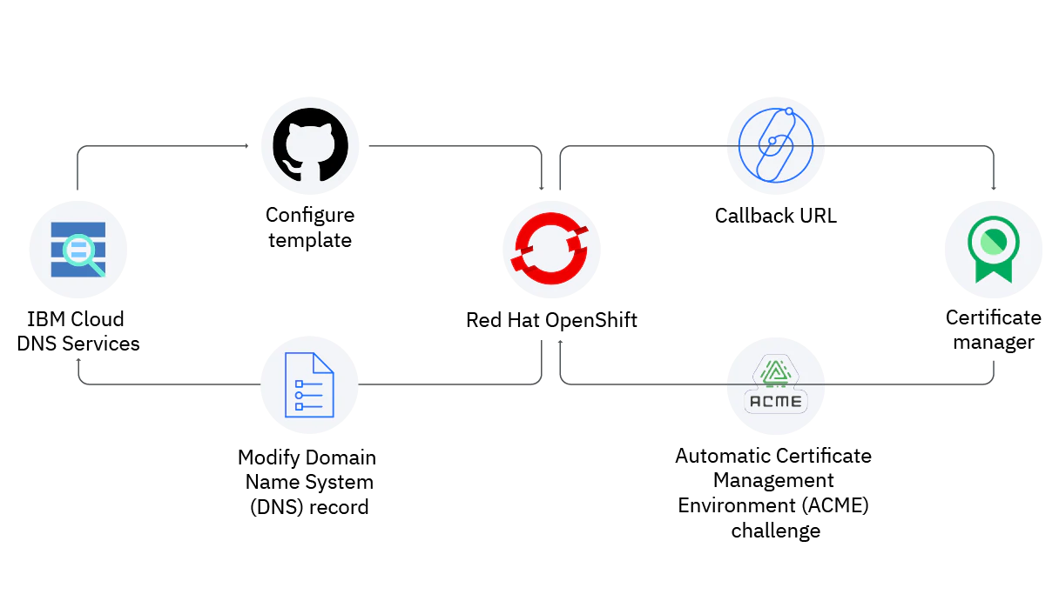
Services in cloud supporting container applications
Red Hat Openshift service on IBM Cloud
OpenShift Container Platform is a private platform-as-a-service (PaaS) for enterprises that run OpenShift on public cloud or on-premises infrastructure.
Image Source: https://www.ibm.com/cloud/openshift
Notes:
Left (White Color space):
Title - Parent Topic
Subtitle - Subtopic 1
Body Text - Description in bullets
Right (Grey Color Space):
Body Text - Relevant image (with source)/code snippet
Put reference links in Speaker Notes
Reference:
https://www.tutorialspoint.com/internet_technologies/internet_overview.htm/

Slide 25
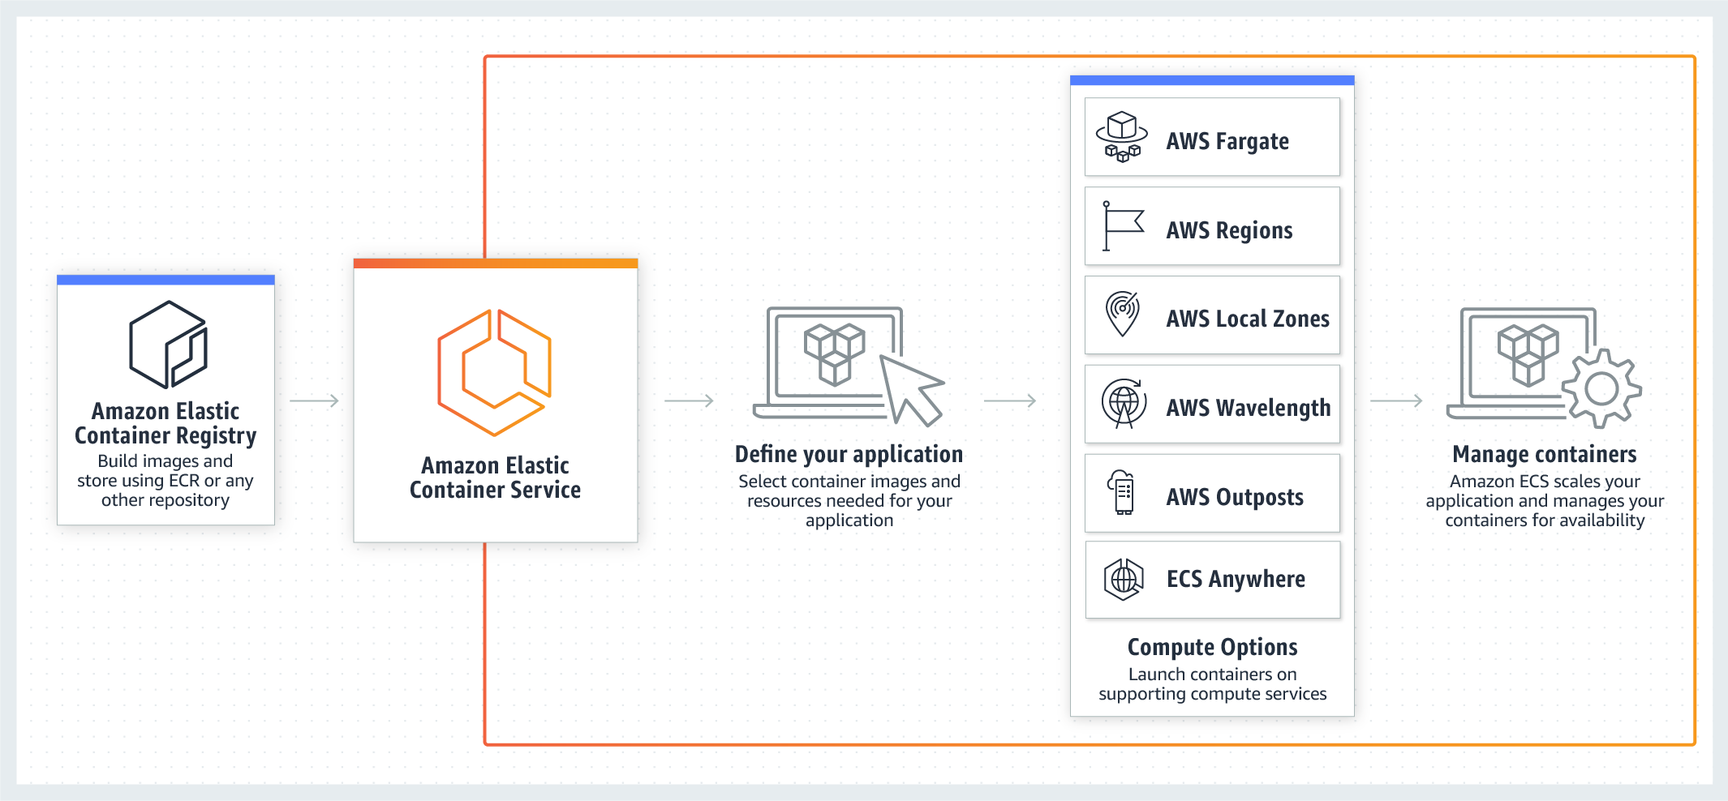
Services in cloud supporting container applications
Amazon ECS on AWS Cloud
Amazon ECS is a fully managed container orchestration service that helps you easily deploy, manage, and scale containerized applications.
Image Source: https://aws.amazon.com/ecs
Notes:
Left (White Color space):
Title - Parent Topic
Subtitle - Subtopic 1
Body Text - Description in bullets
Right (Grey Color Space):
Body Text - Relevant image (with source)/code snippet
Put reference links in Speaker Notes
Reference:
https://www.tutorialspoint.com/internet_technologies/internet_overview.htm/

Slide 26
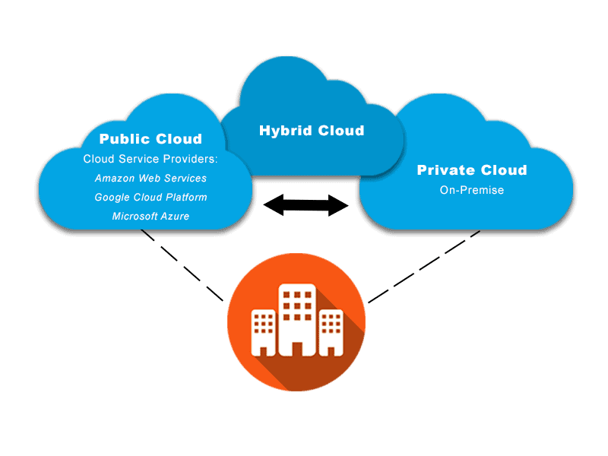
Hybrid Application scenarios
Safe harbor: private environment as gateway to the cloud world
A hybrid cloud infrastructure with a uniform software and hardware basis to ensure maximum compatibility between the public and private clouds.
Image Source: https://avinetworks.com/glossary/hybrid-cloud/
Notes:
Left (White Color space):
Title - Parent Topic
Subtitle - Subtopic 1
Body Text - Description in bullets
Right (Grey Color Space):
Body Text - Relevant image (with source)/code snippet
Put reference links in Speaker Notes
Reference:
https://www.tutorialspoint.com/internet_technologies/internet_overview.htm/

Slide 27
Hybrid Application scenarios
Burst scenario – the public cloud as a buffer for peak loads
Private and public clouds can be smoothly combined to form what is known as cloud bursting.
This enables companies to flexibly absorb peak loads at any time by switching storage and computing resources on and off as required.
Image Source: https://avinetworks.com/glossary/hybrid-cloud/
Notes:
Left (White Color space):
Title - Parent Topic
Subtitle - Subtopic 1
Body Text - Description in bullets
Right (Grey Color Space):
Body Text - Relevant image (with source)/code snippet
Put reference links in Speaker Notes
Reference:
https://www.tutorialspoint.com/internet_technologies/internet_overview.htm/

Slide 28
Hybrid Application scenarios
Backup and disaster recovery with the hybrid cloud
Hybrid cloud scenarios can also be used as backup or disaster recovery solutions.
The public cloud is an inexpensive long-term storage solution. For maximum security, for example, data can be stored in encrypted form in the Object Based Storage.
Image Source: https://avinetworks.com/glossary/hybrid-cloud/
Notes:
Left (White Color space):
Title - Parent Topic
Subtitle - Subtopic 1
Body Text - Description in bullets
Right (Grey Color Space):
Body Text - Relevant image (with source)/code snippet
Put reference links in Speaker Notes
Reference:
https://www.tutorialspoint.com/internet_technologies/internet_overview.htm/

Slide 29
Hybrid Application scenarios
Application development with DevOps – develop once, run anywhere
Hybrid cloud platforms enable teams to develop software faster and to shorten release procedures.
Applications can be ported as needed between teams and their respective private or public environments.
Image Source: https://avinetworks.com/glossary/hybrid-cloud/
Notes:
Left (White Color space):
Title - Parent Topic
Subtitle - Subtopic 1
Body Text - Description in bullets
Right (Grey Color Space):
Body Text - Relevant image (with source)/code snippet
Put reference links in Speaker Notes
Reference:
https://www.tutorialspoint.com/internet_technologies/internet_overview.htm/

Slide 30
Hybrid Application scenarios
Real-time data processing – minimum latency, maximum power
Edge Computing and the hybrid cloud cultivate a close relationship,
Because even with Edge Computing, companies can make use of decentralized computing and storage capacities as required.
Image Source: https://avinetworks.com/glossary/hybrid-cloud/
Notes:
Left (White Color space):
Title - Parent Topic
Subtitle - Subtopic 1
Body Text - Description in bullets
Right (Grey Color Space):
Body Text - Relevant image (with source)/code snippet
Put reference links in Speaker Notes
Reference:
https://www.tutorialspoint.com/internet_technologies/internet_overview.htm/

Slide 31
Hybrid Application scenarios
IT departments as service providers and cloud brokers
Hybrid cloud solutions offer IT departments the opportunity to change things by building a unified service catalog and establishing themselves as the company’s cloud brokers.
Image Source: https://avinetworks.com/glossary/hybrid-cloud/
Notes:
Left (White Color space):
Title - Parent Topic
Subtitle - Subtopic 1
Body Text - Description in bullets
Right (Grey Color Space):
Body Text - Relevant image (with source)/code snippet
Put reference links in Speaker Notes
Reference:
https://www.tutorialspoint.com/internet_technologies/internet_overview.htm/

Slide 32
Hybrid Application scenarios
Provide remote locations without network infrastructure with the cloud
Telekom can implement the necessary servers directly where they are needed.
A connection to the Internet or the public cloud is not absolutely necessary for operating them.
Image Source: https://avinetworks.com/glossary/hybrid-cloud/
Notes:
Left (White Color space):
Title - Parent Topic
Subtitle - Subtopic 1
Body Text - Description in bullets
Right (Grey Color Space):
Body Text - Relevant image (with source)/code snippet
Put reference links in Speaker Notes
Reference:
https://www.tutorialspoint.com/internet_technologies/internet_overview.htm/

Slide 33
Hybrid Application scenarios
Outlook: Using thermal energy from data centers sensibly
Servers give off a lot of heat,
To ensure an optimum operation, the hardware in data centers is usually cooled.
This results in double the energy requirements – once for server operation and then again for cooling. But it’s also possible to make sensible use of the thermal energy from servers.
Image Source: https://avinetworks.com/glossary/hybrid-cloud/
Notes:
Left (White Color space):
Title - Parent Topic
Subtitle - Subtopic 1
Body Text - Description in bullets
Right (Grey Color Space):
Body Text - Relevant image (with source)/code snippet
Put reference links in Speaker Notes
Reference:
https://www.tutorialspoint.com/internet_technologies/internet_overview.htm/

Slide 34
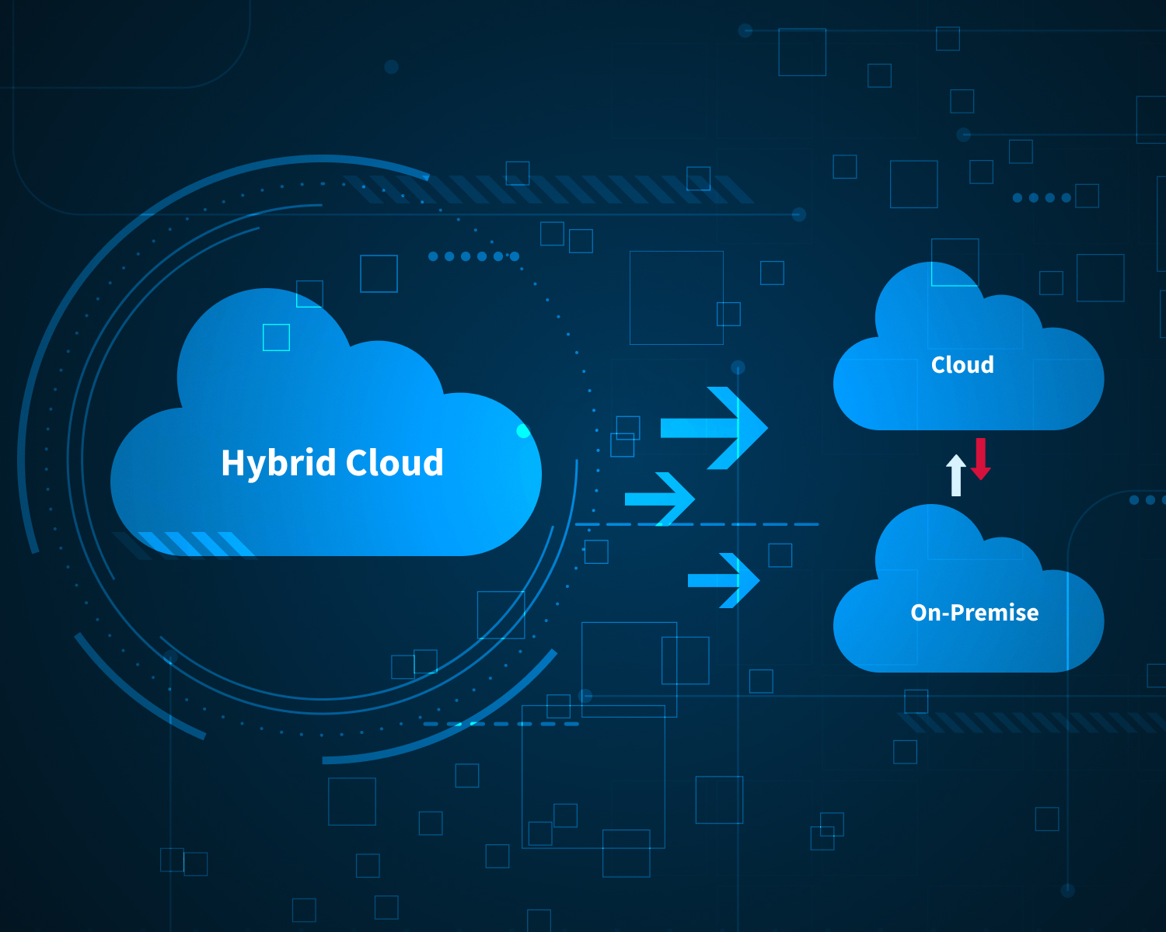
Hybrid architectures and best practices
Four Architecture Choices for Application Development in the Digital Age
Previously, functionality and statefulness were prioritized, but now most consumer-facing applications are moving to Software-as-a-Service (SaaS) and digital platforms.
The application design focus is now much more focused on user experience, statelessness, and agility.
Image Source: https://nix-united.com/blog/hybrid-cloud-architecture-mix-of-best-data-driven-practices/
Notes:
Left (White Color space):
Title - Parent Topic
Subtitle - Subtopic 1
Body Text - Description in bullets
Right (Grey Color Space):
Body Text - Relevant image (with source)/code snippet
Put reference links in Speaker Notes
Reference:
https://www.tutorialspoint.com/internet_technologies/internet_overview.htm/

Slide 35
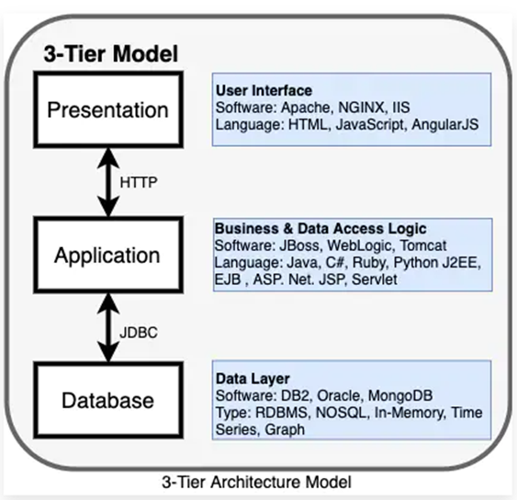
Hybrid architectures and best practices
Traditional 3-tier application architecture
It is a client-server architecture with a typical structure consisting of the presentation layer, application layer, and database layer.
Image Source: https://www.ibm.com/cloud/blog/four-architecture-choices-for-application-development
Notes:
Left (White Color space):
Title - Parent Topic
Subtitle - Subtopic 1
Body Text - Description in bullets
Right (Grey Color Space):
Body Text - Relevant image (with source)/code snippet
Put reference links in Speaker Notes
Reference:
https://www.tutorialspoint.com/internet_technologies/internet_overview.htm/

Slide 36
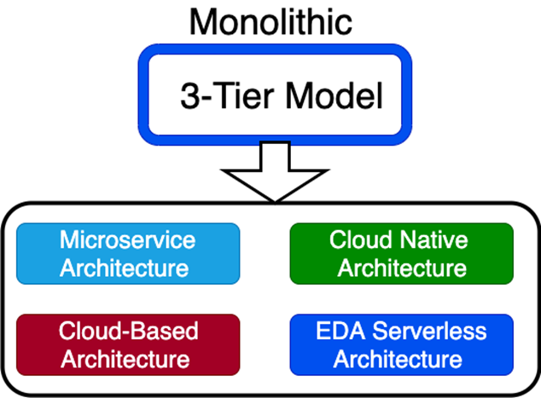
Hybrid architectures and best practices
Traditional 3-tier application architecture
Issue with 3-tier application architecture
Outdated
Over time, an application can become too large and complex to make frequent changes.
Monolithic architecture
Image Source: https://www.ibm.com/cloud/blog/four-architecture-choices-for-application-development
Notes:
Left (White Color space):
Title - Parent Topic
Subtitle - Subtopic 1
Body Text - Description in bullets
Right (Grey Color Space):
Body Text - Relevant image (with source)/code snippet
Put reference links in Speaker Notes
Reference:
https://www.tutorialspoint.com/internet_technologies/internet_overview.htm/

Slide 37
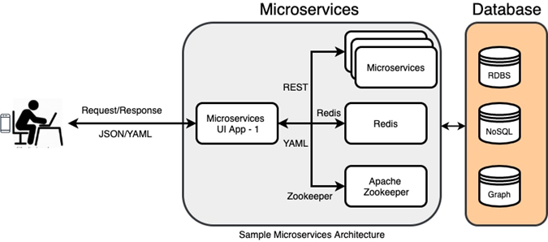
Hybrid architectures and best practices
Microservices architecture
Microservices are an architectural style that structures the application as a collection of services.
Each service can be written in a different programming language and tested separately.
They are independently deployable and organized around business capabilities.
Image Source: https://www.ibm.com/cloud/blog/four-architecture-choices-for-application-development
Notes:
Left (White Color space):
Title - Parent Topic
Subtitle - Subtopic 1
Body Text - Description in bullets
Right (Grey Color Space):
Body Text - Relevant image (with source)/code snippet
Put reference links in Speaker Notes
Reference:
https://www.tutorialspoint.com/internet_technologies/internet_overview.htm/

Slide 38
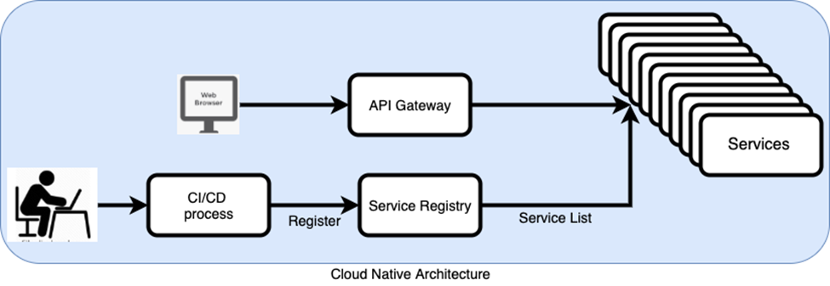
Hybrid architectures and best practices
Cloud native architecture
Cloud native is an approach to building and running applications that exploits the advantages of the cloud computing delivery model.
Cloud native is a term used to describe container-based environments, and it is about how applications are created and deployed, not where.
Image Source: https://www.ibm.com/cloud/blog/four-architecture-choices-for-application-development
Notes:
Left (White Color space):
Title - Parent Topic
Subtitle - Subtopic 1
Body Text - Description in bullets
Right (Grey Color Space):
Body Text - Relevant image (with source)/code snippet
Put reference links in Speaker Notes
Reference:
https://www.tutorialspoint.com/internet_technologies/internet_overview.htm/

Slide 39
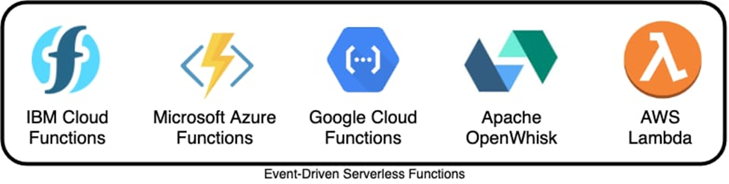
Hybrid architectures and best practices
Event-driven serverless architecture
Event-driven architecture (EDA) is based on decoupled systems that run in response to events.
An event-driven architecture uses events to trigger and communicate between decoupled services.
Image Source: https://www.ibm.com/cloud/blog/four-architecture-choices-for-application-development
Notes:
Left (White Color space):
Title - Parent Topic
Subtitle - Subtopic 1
Body Text - Description in bullets
Right (Grey Color Space):
Body Text - Relevant image (with source)/code snippet
Put reference links in Speaker Notes
Reference:
https://www.tutorialspoint.com/internet_technologies/internet_overview.htm/

Slide 40
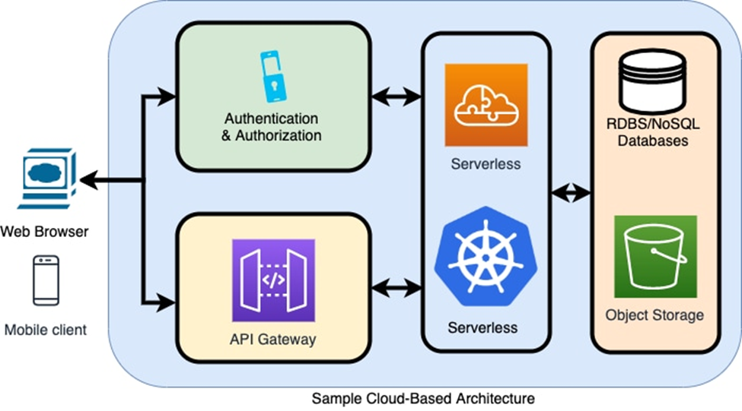
Hybrid architectures and best practices
Cloud-based architecture
API Gateway is an important service that makes it easy for developers to create and publish secure APIs.
The APIs will act as a front door for applications to access data and business logic.
It also takes care of authorization and access control.
Image Source: https://www.ibm.com/cloud/blog/four-architecture-choices-for-application-development
Notes:
Left (White Color space):
Title - Parent Topic
Subtitle - Subtopic 1
Body Text - Description in bullets
Right (Grey Color Space):
Body Text - Relevant image (with source)/code snippet
Put reference links in Speaker Notes
Reference:
https://www.tutorialspoint.com/internet_technologies/internet_overview.htm/

Slide 41
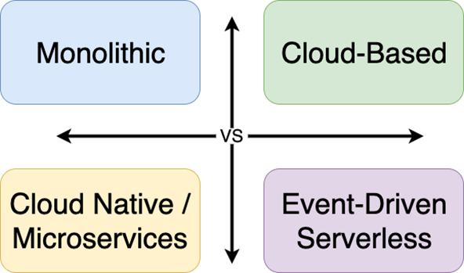
Hybrid architectures and best practices
How to decide which architecture model is best for your application?
Consider the following before choosing an architecture for your app project:
Is it monolithic-first or microservice-first? (For smaller projects with a simple application requirement, monolithic may be a right choice.)
Image Source: https://www.ibm.com/cloud/blog/four-architecture-choices-for-application-development
Notes:
Left (White Color space):
Title - Parent Topic
Subtitle - Subtopic 1
Body Text - Description in bullets
Right (Grey Color Space):
Body Text - Relevant image (with source)/code snippet
Put reference links in Speaker Notes
Reference:
https://www.tutorialspoint.com/internet_technologies/internet_overview.htm/

Slide 42
Hybrid architectures and best practices
How to decide which architecture model is best for your application?
Is your team ready to utilize microservices?
Does your team have an existing cloud-based DevOps and CI/CD process?
What is your hosting model? Private, public, hybrid?
Image Source: https://www.ibm.com/cloud/blog/four-architecture-choices-for-application-development
Notes:
Left (White Color space):
Title - Parent Topic
Subtitle - Subtopic 1
Body Text - Description in bullets
Right (Grey Color Space):
Body Text - Relevant image (with source)/code snippet
Put reference links in Speaker Notes
Reference:
https://www.tutorialspoint.com/internet_technologies/internet_overview.htm/

Slide 43
Hybrid architectures and best practices
How to decide which architecture model is best for your application?
How does the application architecture affect your project?
Does a combination of multiple architecture model work for you?
Do you need persistence and sessions for your applications?
Image Source: https://www.ibm.com/cloud/blog/four-architecture-choices-for-application-development
Notes:
Left (White Color space):
Title - Parent Topic
Subtitle - Subtopic 1
Body Text - Description in bullets
Right (Grey Color Space):
Body Text - Relevant image (with source)/code snippet
Put reference links in Speaker Notes
Reference:
https://www.tutorialspoint.com/internet_technologies/internet_overview.htm/

